Slide 1

Capstone
Project
Imarticus Learning

Slide 2
Introduction:- Spotify Music Analysis
This dashboard provides an in-depth analysis of Spotify's music streaming data. By examining trends, key metrics, and patterns, it helps us understand listener preferences, top-performing tracks, and their characteristics. This insight aids in strategic decision-making for artists, producers, and the music industry.
Imarticus Learning

Slide 3
Problem Statement:- Spotify Music Analysis
With millions of tracks on Spotify, understanding streaming performance and audience behavior is crucial for identifying trends, optimizing playlists, and marketing effectively. This analysis addresses the following questions:
What are the most popular tracks and their attributes?
How do streaming trends vary over time?
What insights can we derive from audience listening patterns?
How can energy, speechiness, and liveness metrics influence track popularity?
Imarticus Learning

Slide 4
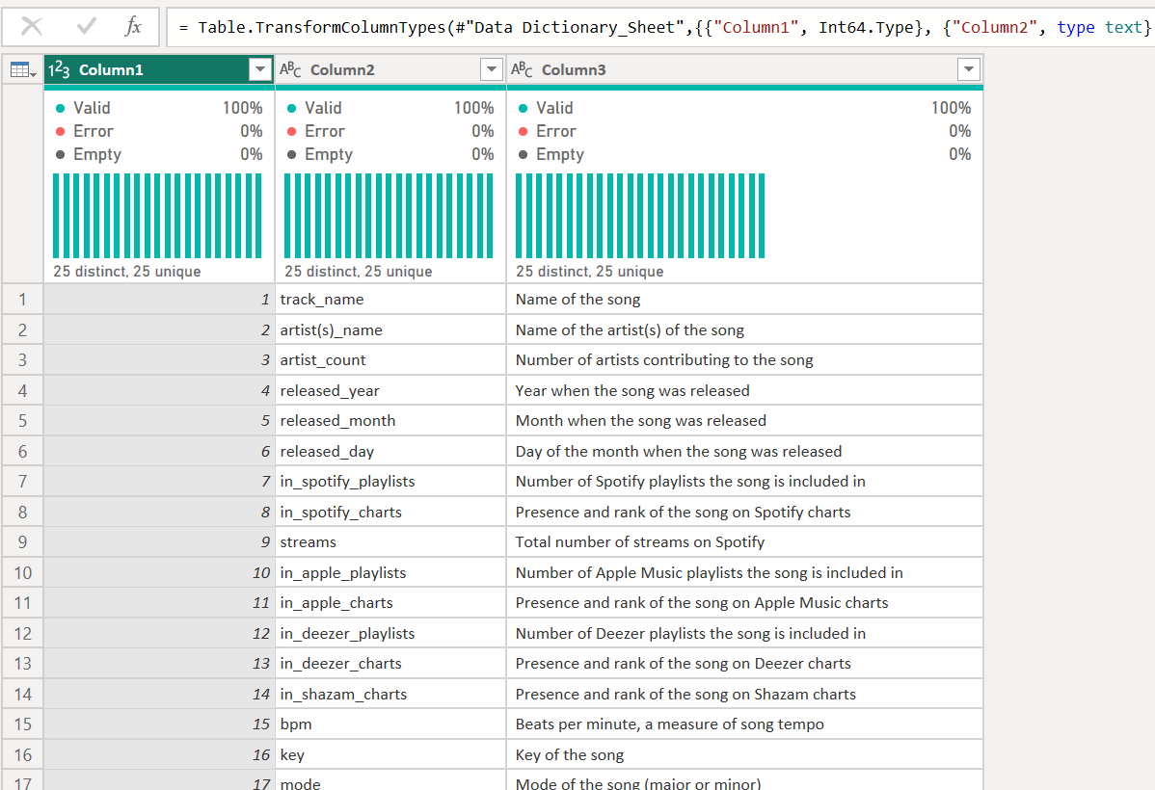
Spotify Music Analysis
Imarticus Learning

Slide 5
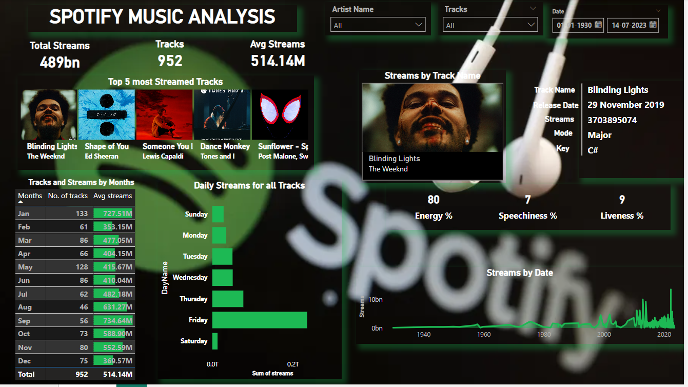
Imarticus Learning

Slide 6



Spotify Data Analysis
The dataset includes:
Total Streams: 489 billion streams from 952 tracks.
Time Period: January 1, 1930 – July 14, 2023.
Imarticus Learning

Slide 7



Spotify Data Analysis
Key Features:
Track metadata: Name, artist, release date, mode, key.
Performance metrics: Streams, energy, speechiness, liveness.
Temporal breakdown: Monthly and daily streams
Imarticus Learning

Slide 8
Spotify Data Analysis
Data Model
The data model consolidates track attributes and performance metrics, linking them through temporal patterns and user engagement indicators. Key elements include:
Track Metadata: Name, artist, release date, musical key, and mode (major/minor).
Performance Metrics:
Streams by track and time.
Popularity factors like energy, speechiness, and liveness.
Temporal Data: Month-wise and day-wise stream analysis.
Imarticus Learning

Slide 9
Data Visualization
Spotify Data Analysis
Data Visualization
Top 5 Most Streamed Tracks
Insight: "Blinding Lights" by The Weekend is the most streamed track, followed by "Shape of You" by Ed Sheeran.
Tracks and Streams by Months
Insight: January and September exhibit the highest average streams per track (727.51M and 734.64M respectively), indicating peak listening periods.
Daily Streams Distribution
Insight: Fridays show the highest streaming activity, reflecting weekend anticipation.
Imarticus Learning

Slide 10
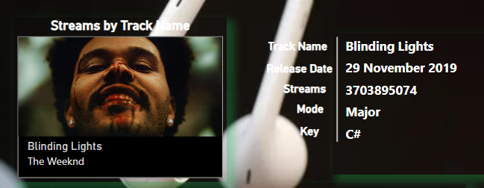
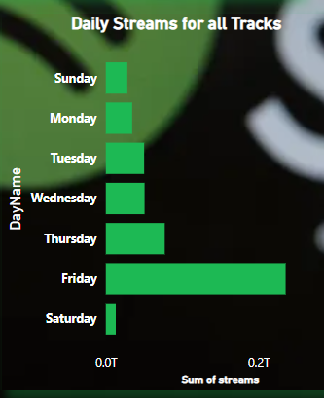
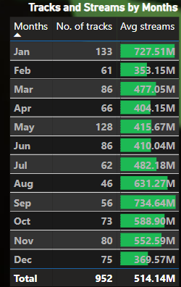
Spotify Data Analysis
Imarticus Learning

Slide 11
Spotify Data Analysis
Data Visualization
Streams by Track Attributes
Example: "Blinding Lights":
Energy: 80%
Speechiness: 7%
Liveness: 9%
Streams by Date
Insight: Streaming activity significantly increases after 2000, showcasing the rise of digital platforms.
Imarticus Learning

Slide 12



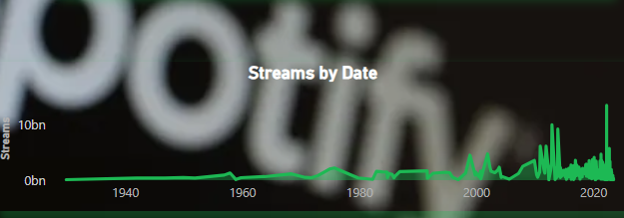
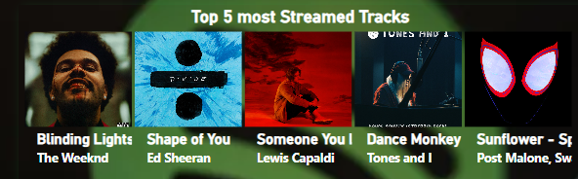
Spotify Data Analysis
Imarticus Learning

Slide 13
Spotify Data Analysis
Conclusion
The Spotify Music Analysis Dashboard provides valuable insights into streaming trends, track performance, and audience behavior. Key takeaways include:
Track Popularity: Tracks like "Blinding Lights" and "Shape of You" exemplify how specific attributes like energy and liveness resonate with listeners.
Temporal Trends: Fridays and certain months experience higher streaming activity, emphasizing the importance of timing in music releases and promotions.
Digital Revolution: The post-2000 surge in streaming highlights the transformative role of digital platforms in music consumption.
Audience Preferences: Attributes such as speechiness and energy are critical in determining track success and engagement.
Imarticus Learning

Slide 14
THANK YOU
Imarticus Learning

